Slide 1
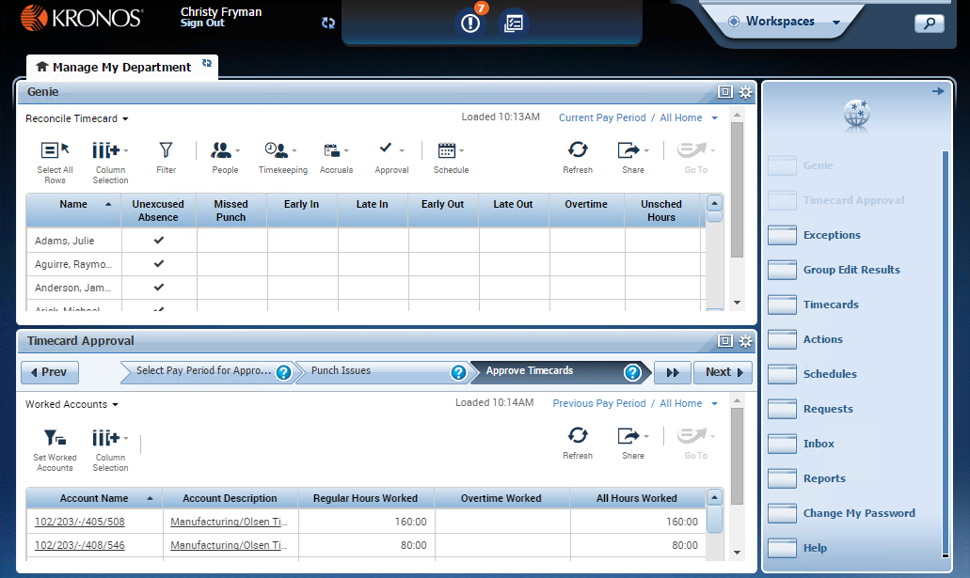
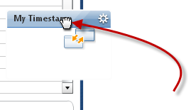
Manager Navigator Job Aid
Parts of a Navigator
Active Bar Displays active workspaces; click title to bring a workspace into focus. (Manage My Department is the only one in this example.) Click the Refresh icon next to the title to reload the workspace with its default information.
Name / Sign Out Identifies user and a link to log out of navigator.
Alerts Links, which appear as icons, enabling you to quickly view the type and number of tasks and issues that you need to address.
Carousel Container for one or more workspaces (Note: Appears only if there is another workspace. (My Information for Managers is located here)
Search Click to open the Search widget, to locate employees and their information.
Repositioning Widgets Move a secondary widget into a primary position by clicking the title bar, dragging it over a primary widget, and releasing.
New
Contextual Callouts Try right-clicking over a cell in a widget. In many cases this will open a callout with detailed information and icons for any actions you might want to perform on that cell.
Navigator layouts vary
Navigators are customized by Administrators and reflect those items needed for a job role. Specific widgets and alerts that are available in your navigator are determined by your access and which applications are in use.
Workspace A work area made up of one or more views and the Related Items pane.
Views and Widgets A workspace can have one or more pre-sized views. Views are holding areas for widget, which are the task-oriented tools you use to review data and perform actions. In this example, there are two views, and each one currently holds a widget. When you need to work with a different widget, you can swap it into either view, replacing the current occupant.
Related Items Pane Includes one or more additional widgets for less common tasks; the Related Items pane contains different widgets for each workspace.
© 2016, Kronos Incorporated or a related company. All rights reserved.

Slide 2
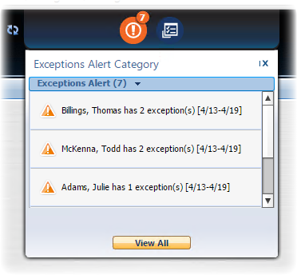
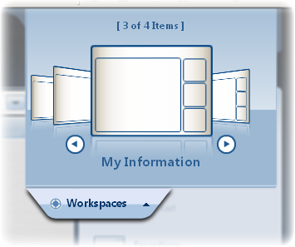
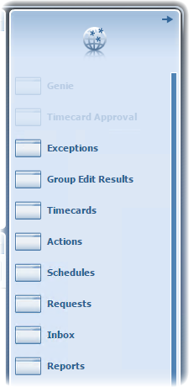
Manager Navigator Job Aid
Opening Widgets and Workspaces
Refresh Click the Refresh icon to get immediate updates to your Alerts.
Alert Icons Each type of alert has its own icon. A number in the icon’s corner indicates that there are items you should review. (The significance of the number itself depends on the specific alert.) Click an icon to view details.
Closing the Carousel Click the Workspaces tab to close the carousel.
Additional Workspaces Click an item in the carousel to open an additional workspace. To close that workspace later, hover over its tab and click the Close (X) button.
Alert Details Click an item in the details of an alert to open the relevant widget. You can then take whatever actions are needed in the open widget.
Cycling the Carousel If there is more than one workspace in the carousel, use the arrows to cycle through the additional workspaces.
View All Click to open the Alerts and Notifications widget. This provides more room for reviewing alerts, and may also include uncategorized alerts and notifications that are not actionable.
Carousel
Closing the Related Items Pane Click the right arrow to close the Related Items pane. When closed, click the left arrow to open it.
Alerts
Active Widgets Widgets already in an open workspace appear grayed out in widget list.
Activating a Widget There are two ways to activate a widget in the Related Items pane. To add it to the current workspace, drag it out of the pane and release it over a widget in the workspace. To work with the widget in a temporary workspace, click the widget while it is still in the pane. To close that workspace later, hover over its tab and click the Close (X) button.
Related
Items
© 2016, Kronos Incorporated or a related company. All rights reserved.

Slide 3
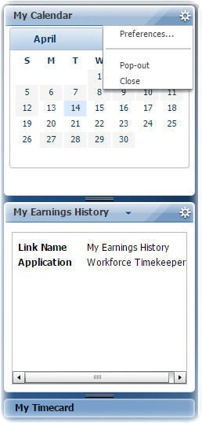
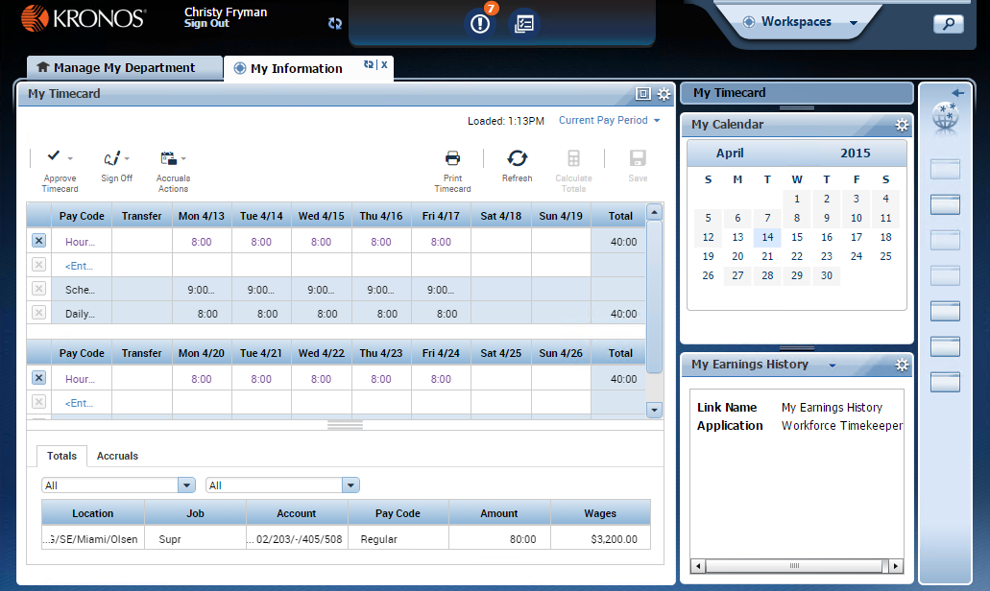
Manager Navigator Job Aid
Managing the Active Workspace
Primary and Secondary Views
Workspace Tabs Each active workspace gets its own tab. You can switch back and forth between workspaces by selecting the tab you want to view. You must always have at least one workspace open, but you can close any additional workspaces by hovering over its tab and clicking the Close (X) button.
All workspaces have at least one primary view, and some also have one or more secondary views. Normally, to work in a widget you must move it into a primary view. Widgets occupying secondary views often provide useful information, but are not fully functional until moved into a primary view.
Two Primary Views?
Gear Icon Click to view options for moving the widget. Unavailable options will be grayed out. (For example, widgets in the primary view cannot use Close or Pop-out.)
Some workspaces feature two equally-size views in a side-by-side or top-and-bottom layout. In this case, both views act as primary views, and widgets in those views are fully functional.
Maximize / Restore Icon Click to expand a widget in a primary view to its maximum size. (This will temporarily hide any other widgets.) Click again when maximized to restore to the original size.
Preferences Option Select Preferences to edit settings for a widget, such as time period, and permanently save the changes. Preferences, if enabled, are saved only for your use in your own widget.
Primary
View
Pop-out Option Select Pop-out to promote a secondary widget to a primary position.
Close Option Select Close to send a widget in a secondary view back to Related Items.
Resize Bar Click and drag the resize bar to reveal more of a particular secondary view.
Title Bar Click and drag a widget’s title bar to swap it with another widget or return it to the Related Items pane.
Secondary
Views
Usable Widgets in a Secondary View In most cases widgets in a secondary view are informational only until promoted to a primary view. However, some widgets, such as My Timestamp, have functioning parts even when in a secondary view.
© 2016, Kronos Incorporated or a related company. All rights reserved.

Slide 4
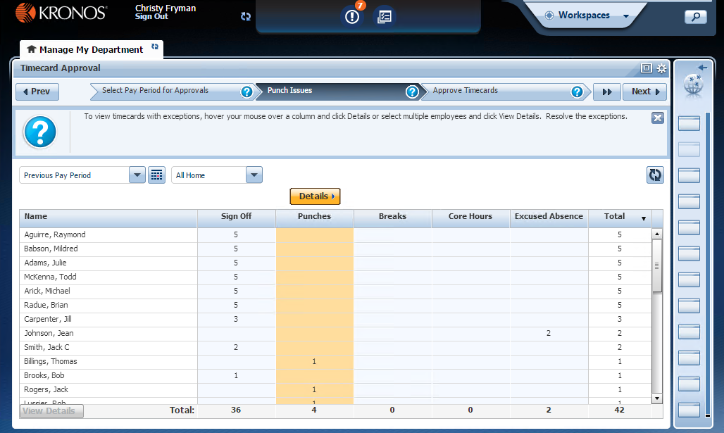
Manager Navigator Job Aid
Using the Timecard Approval Wizard
Previous Button Move back to an earlier step in the wizard.
Steps Each step in the wizard is identified by its own chevron or tab. In some wizards you can click a chevron or tab to go directly to that step.
Information (Question Mark) Click the question mark icon to display helpful instructions for each step. Click X to close the information.
Maximize / Restore It is recommended that you increase your work area when using a wizard. Do this by clicking the Maximize/Restore icon in the widget, or opening the wizard in its own workspace (as in this example). Closing the Related Items pane is also recommended.
What is a Wizard?
A wizard is a specially-designed widget that guides you through a series of steps to perform a business task. Each step presents a Workforce Central page or widget relevant to that step, along with instructions for how to perform that step. A wizard helps you complete a task quickly, easily, and consistently.
Next / Done / Clear Click Next to advance when you are done with the current step. The final step will display either Done or Clear. Click Done or Clear to reset the context and return to the initial step. You can then use the wizard again or move on to another task.
Workforce Central Page or Widget Each step in a wizard contains a Workforce Central page or widget that enables you to complete the step. Perform any required tasks and then click Next to continue to the next step. To see helpful information about the current step, click the step’s question mark icon.
© 2016, Kronos Incorporated or a related company. All rights reserved.

Slide 5
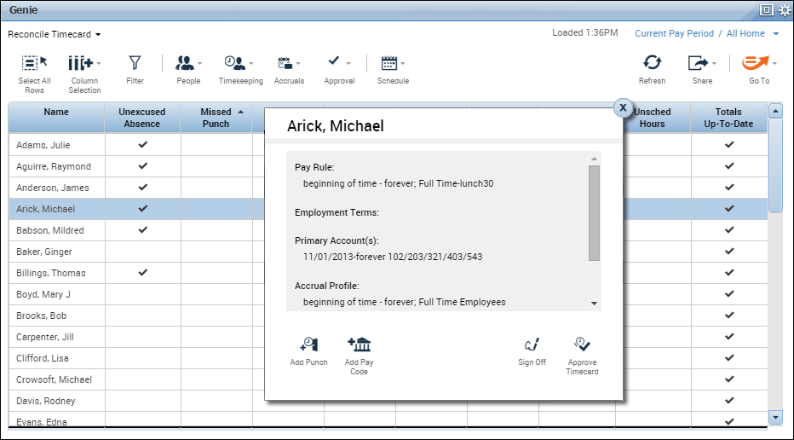
Manager Navigator Job Aid
Using a Workforce Genie
New
New
New
Where are my Genies?
Sorting/Grouping options Click the small arrow that appears when you hover over a column header to see your options for how to sort or group the data by that column.
Action Icons These icons provide access to actions you can take on employees, such as viewing People records or accrual balances, approving timecards, and so on. Start by selecting the individual employee rows (or clicking Select All Rows to select all employees in the display), then choose the action you want to take.
Context Selector Displays the current employee set and date range (which, together, are referred to as “context”) for the genie. To change this context, click it and select a new one from the resulting drop-down list.
GoTo Open this drop-down list and select a widget or workspace to navigate to. Your new destination will retain the same context (i.e. set of employees and range of dates) as the one you were just using in the Genie, instead of using its default context. This option is helpful if you would like to perform tasks on the same set of employees and/or the same time period over a series of several widgets.
While Genies can be presented individually in their own widget, you may also have a Genies widget containing multiple Genies. If you can’t find a particular Genie in your Navigator, it might be located in the Genie selector.
New
Genie Selector Open this drop-down list to select a specific Workforce Genie to work with. This is only available if the widget contains more than one Genie.
Share Provides options for printing the data displayed in the genie, or exporting it to a spreadsheet format.
New
Select/Unselect All Rows Click this shortcut to select all displayed rows before performing another action. Click again to unselect all rows.
Refresh Discards any unsaved edits in the genie, and then reload the genie with the most current data in the database.
New
New
Column Selection Click this icon to open a list of available columns for the genie. You can then selectively turn columns on or off to customize your display. You selections will persist (even between sessions) until you change them.
Contextual Callouts Try right-clicking over a cell or person in the genie. In many cases this will open a callout with detailed information and icons for any actions you might want to perform on that cell or person.
New
How do I save my edits?
Filter Toggling this on displays filter fields at the top of any columns that can be filtered. As you type in any of these filter fields, only rows containing the characters you type will remain in the workspace.
When you take action in a genie, it is immediately saved to the database; you do not manually make a save. You can view the Group Edit Results widget to verify that your edits were successful.
© 2016, Kronos Incorporated or a related company. All rights reserved.

Slide 6
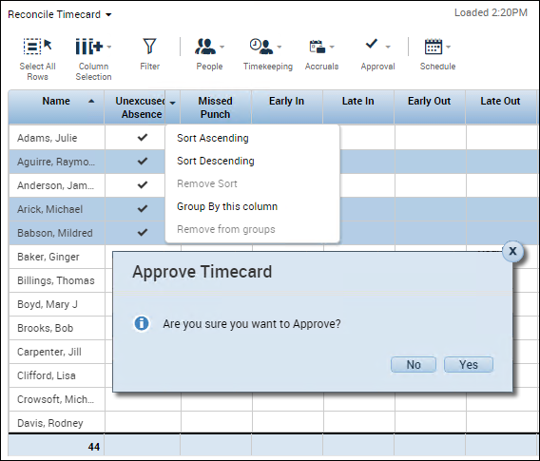
Manager Navigator Job Aid
Performing Common Manager Tasks
New
Making a group edit in a Workforce Genie
When you are working in a Genie, you can select a group of employees and apply the same edit to all of them simultaneously, saving time and reducing the chance of error.
3
1
In the Genie, if there is a specific column that will conveniently sort the group of employees you wish to edit, use the column’s Sorting/Grouping option to sort by that column. (For example, if you intend to approve only the timecards of employees who have approved their own timecard, you could sort on the Employee Approval column.)
1
2
Select the employees to whom you want to apply the edit.
To select individual employees, hold down the Control key while selecting names.
To select a contiguous set of employees, select the first employee and then hold down the Shift key while selecting the last employee.
To select all employees, click the Select All Rows action icon.
2
3
With the employees selected, click the action icon related to the edit you want to perform. If a drop-down list with further options appears, select the appropriate action and when prompted provide any further details needed to make the edit.
4
4
Click Apply (or Yes) to apply and save the edit.
Using Goto navigation
Using the Search widget
Goto navigation makes it possible for you to select a specific context (i.e. group of employees and time period) in the widget you are currently viewing, and carry that context with you to another widget. This is convenient if you need to view information and/or perform tasks spread across several widgets, with the same group of employees.
The Search widget enables users to search on a variety of Workforce Central items, such as employees, configuration rules, exceptions, and more. It can return a list of employees for which the search/filter is true, often saving you from having to dig deeper for the information you need.
For example, you could search on the word over and select the Unapproved Overtime suggestion to view all of your employees who have unapproved overtime.
1
In a Genie (or the Search widget) select the group of employees you want to carry over to a new widget, using the same selection approach as you would when making a group edit (see Making a group edit in a Workforce Genie).
Note: If you are in a widget that only shows one employee’s information at a time (such as the Timecards widget), the context will show that you have a certain number of employees selected. These employees will be carried over.
1
Click the Search icon in the upper right corner of Navigator.
2
In the search field, start typing the name of the item (employee, rule, exception, etc.) that you want to search on. As you type a list of suggestions will appear below.
2
Open the Goto menu and select the widget or workspace you would like to move to.
3
If the item you are looking for appears in the list of suggestions, select it and the item’s details will appear in the right half of the widget. If you want to perform a task with any of the employees that appear, you can select them and use Goto navigation to carry them into another widget.
You can continue to move to new widgets with the selected employees (or a subset of those employees, if you choose). To “reset” your selection when you are done working with those employees, click the workspace’s Refresh icon.
4
If your search did not locate what you were looking for, you can clear the search by clicking . . You can then enable the Hints (On) option and use the items in the drop-down list that appears to help you locate it.
© 2016, Kronos Incorporated or a related company. All rights reserved.

