Slide 1
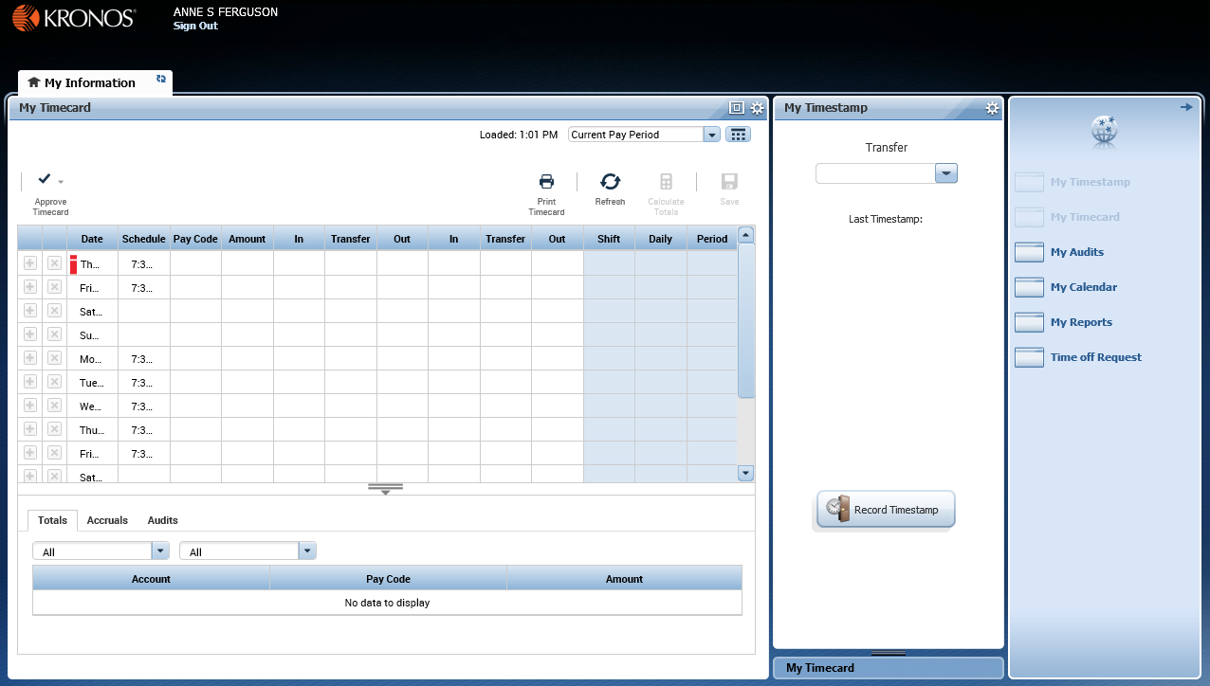
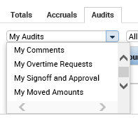
Hourly Employee Navigator Job Aid
Parts of a Navigator
To maximize or minimize Timecard
Opens in a separate tab beside “My Information”
© 2015, Kronos Incorporated or a related company. All rights reserved.

Slide 2
Hourly Employee Navigator Job Aid
Performing Common Employee Tasks
Entering time in the My Timecard widget
If you need to add or edit your worked or non-worked time, you must contact your manager for the needed edits to be made.
New
Approving your timecard
Reviewing your accrual balances
After you review your timecard for accuracy at the end of a pay period, and agree that all the information is correct, you should approve you timecard so your manager knows it is ready to go to payroll. Make sure the My Timecard widget is in a primary view.
You can review any time off balances you have accrued right in your timecard. Make sure the My Timecard widget is in a primary view.
1
In the My Timecard widget, make sure you are viewing the date for which you would like to view your available balances. (For example, if you want to want to review your balances as of April 3, make sure a row for April 3 is displayed in the timecard.) If the date is not showing, click the currently-selected time period, click the Select Dates
icon , select the date you want from the calendar, and click Apply.
1
In the My Timecard widget, make sure you are viewing the time period you want to approve.
2
After verifying that you want to approve all entries of the dates appearing the timecard, click the Approve Actions icon and select Approve Timecards.
After applying an approval, you will no longer be able to edit your timecard for that pay period (as indicated by the timecard’s colored background). If you later determine that you need to make an edit, click the Approve Actions icon and select Remove Timecard Approval. You can then make your edit(s) and approve the timecard again.
2
Select the row of the date for which you want to check your balance, and select the Accruals tab at the bottom of your timecard. Your accrual balances will appear in the tab. The values in the Accrual Available Balance column tell you how many hours you have available in each of the types of hours you accrue.
© 2015, Kronos Incorporated or a related company. All rights reserved.

Slide 3
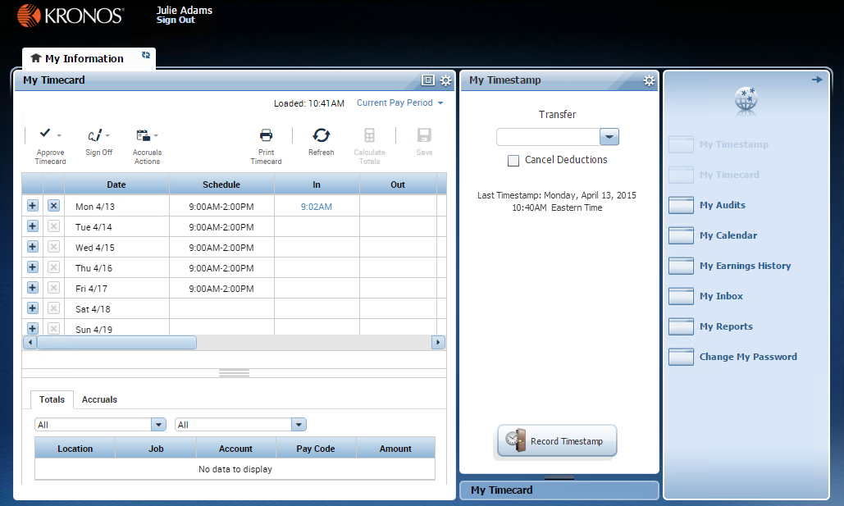
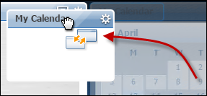
Hourly Employee Navigator Job Aid
Parts of a Navigator
Active Bar Displays active workspaces; click title to bring a workspace into focus. (My Information is the only one in this example.)
Name / Sign Out Identifies user and a link to log out of navigator.
Time Period Allows you to choose a Time Period to work with. To change the time period, click the current one, select a new one, and click Apply.
Related Items Pane The Related Items pane contains additional, less commonly used widgets. Click the arrow in the upper right corner to open or close the pane.
Repositioning Widgets Move a widget from a secondary view to a primary view by clicking the title bar, dragging it over a primary view, and releasing. Most edits must be applied in a primary view.
Active Widgets Widgets already in an open workspace appear grayed out in the widget list.
Activating a Widget There are two ways to activate a widget in the Related Items pane. To add it to the current workspace, drag it out of the pane and release it over a widget in the workspace. To work with the widget in a temporary workspace, click the widget while it is still in the pane. To close that workspace later, hover over its tab and click the Close (X) button.
Workspace A work area made up of one or more views and the Related Items pane.
Views and Widgets A workspace can have one or more pre-sized views. Views are holding areas for widgets, which are the task-oriented tools you use to review data and perform actions. In this example, there are two views, and each one currently holds a widget. When you need to work with a different widget, you can swap it into either view, replacing the current occupant.
New
Navigator layouts vary
Contextual Callouts Try right-clicking over a cell in a widget. In many cases this will open a callout with detailed information and icons for any actions you might want to perform on that cell.
Navigators are customized and reflect those items needed for a job role. Specific widgets that are available in your navigator are determined by your access and which applications are in use.
© 2015, Kronos Incorporated or a related company. All rights reserved.

Slide 4
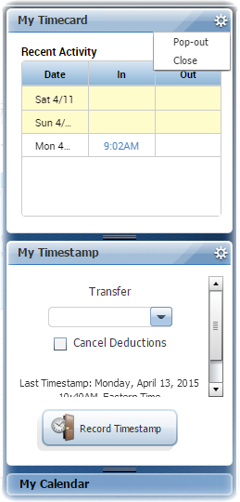
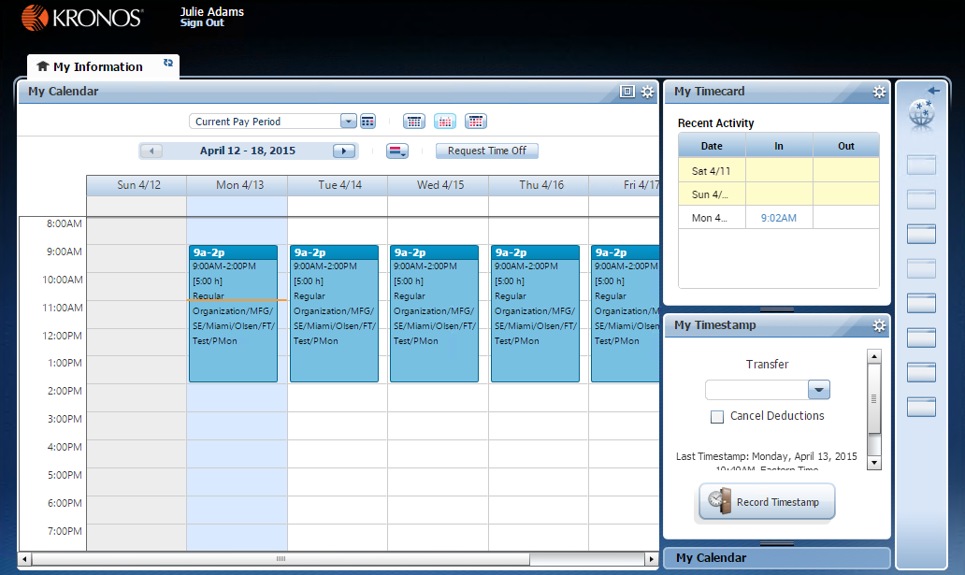
Hourly Employee Navigator Job Aid
Managing the Workspace
Primary and Secondary Views
Workspace Tabs Each active workspace gets its own tab. You can switch back and forth between workspaces by selecting the tab you want to view. You must always have at least one workspace open, but you can close any additional workspaces by hovering over its tab and clicking the Close (X) button.
All workspaces have at least one primary view, and some also have one or more secondary views. Normally, to work in a widget you must move it into a primary view. Widgets occupying secondary views often provide useful information, but are not fully functional until moved into a primary view.
Gear Icon Click to view options for moving the widget. Unavailable options will be grayed out. (For example, widgets in the primary view cannot use Close or Pop-out.)
Maximize / Restore Icon Click to expand a widget in a primary view to its maximum size. (This will temporarily hide any other widgets.) Click again when maximized to restore to the original size.
Pop-out Option Select Pop-out to promote a secondary widget to a primary position.
Primary
View
Close Option Select Close to send a widget in a secondary view back to Related Items.
Resize Bar Click and drag the resize bar to reveal more of a particular secondary view.
Title Bar Click and drag a widget’s title bar to swap it with another widget or return it to the Related Items pane.
Secondary
Views
Usable Widgets in a Secondary View In most cases widgets in a secondary view are informational only until promoted to a primary view. However, some widgets, such as My Timestamp, have functioning parts even when in a secondary view.
© 2015, Kronos Incorporated or a related company. All rights reserved.

